Slide 1

External Stimulators for Quality Improvement
Beyond Accreditation
I International Conference on Nursing
Astana - June 22-23, 2018

Slide 2
Outline
Internal and external quality assurance
Why nurses should be involved in quality assurance?
Prospective and retrospective view on quality
Best source for quality indicators
Non-fault approach

Slide 3
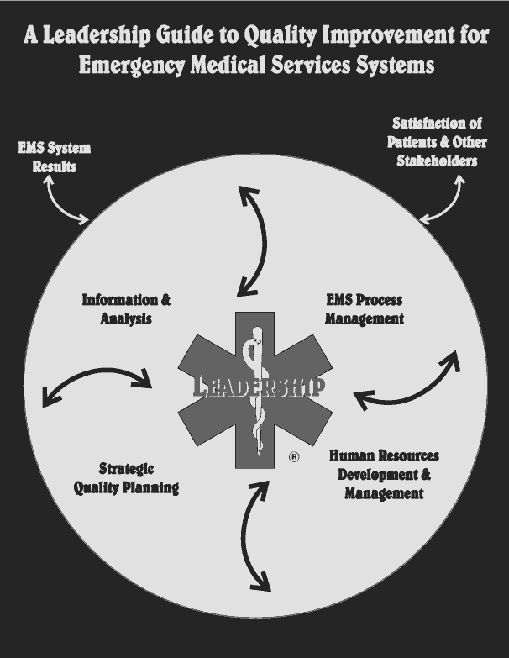
Internal and external quality assurance
Fundamental for quality improvement is internal quality cycle
But some external assessments help

Slide 4
External quality assessment stimulate internal activities that change quality of care

Slide 5
External quality assessment systems
Health care
      accreditation
      „visitatie” (only Netherlands)
Industry
      ISO certification
      EFQM, Baldrige, Juran awards

Slide 6

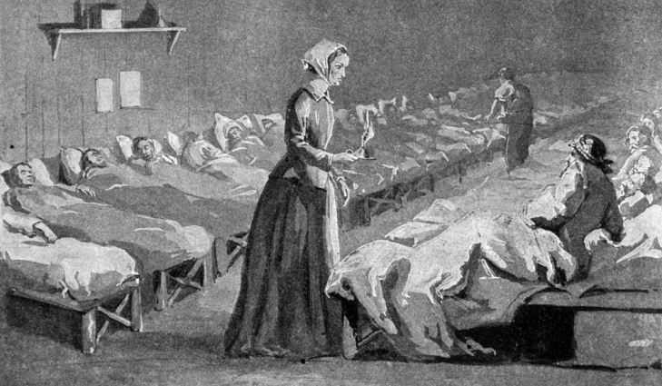
Why nurses should be involved in quality assurance ?
Historical reason: common famous pioneer of nursing and quality assurance in hospital care

Slide 7
Why nurses should be involved in quality assurance ?
Nurses already proved their important role in accreditation processes
Many nurses are enough ambitious to play more important role in a system
Modern technologies press on doctors to be more involved in technical skills

Slide 8
Two types of external assessment
Based on standards
function according to high standards give big chances for good results
prospective perspective
Based on performance
achieving good results means proper functioning
retrospective perspective

Slide 9
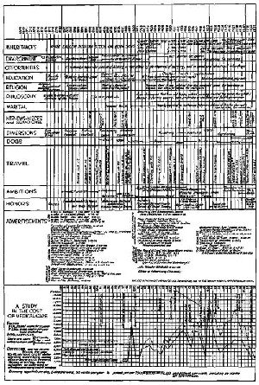
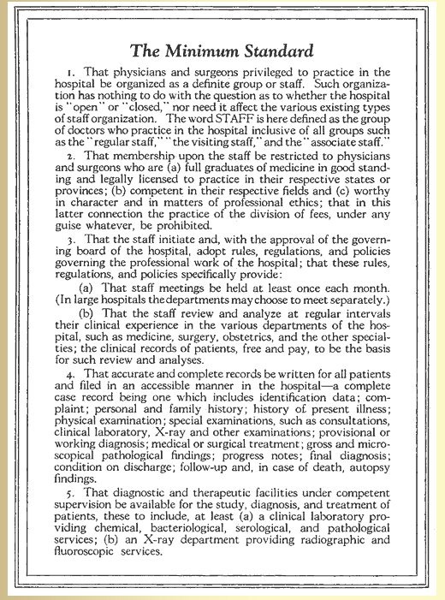
Dr Ernest Codman
approaches at beginning of XX century
End Results
Minimum Standard

Slide 10
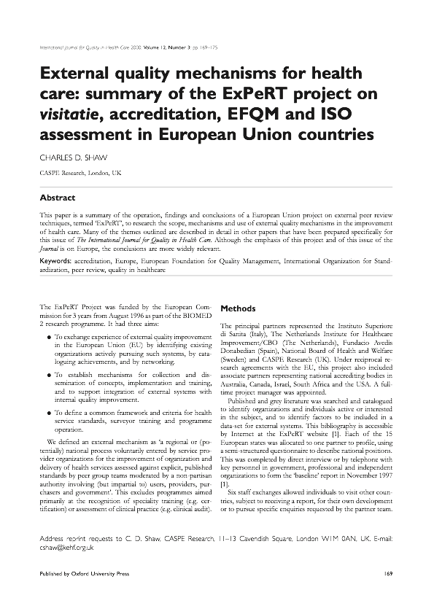

External Q assessment in EU
Charles Shaw

Slide 11
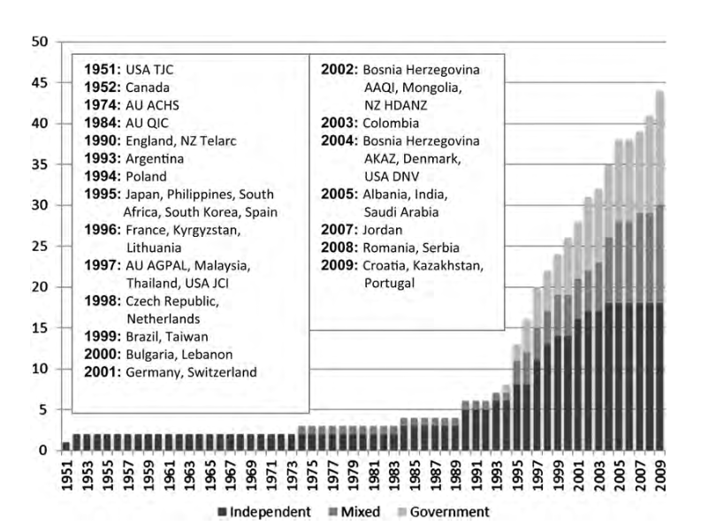
Increase in accreditation

Slide 12
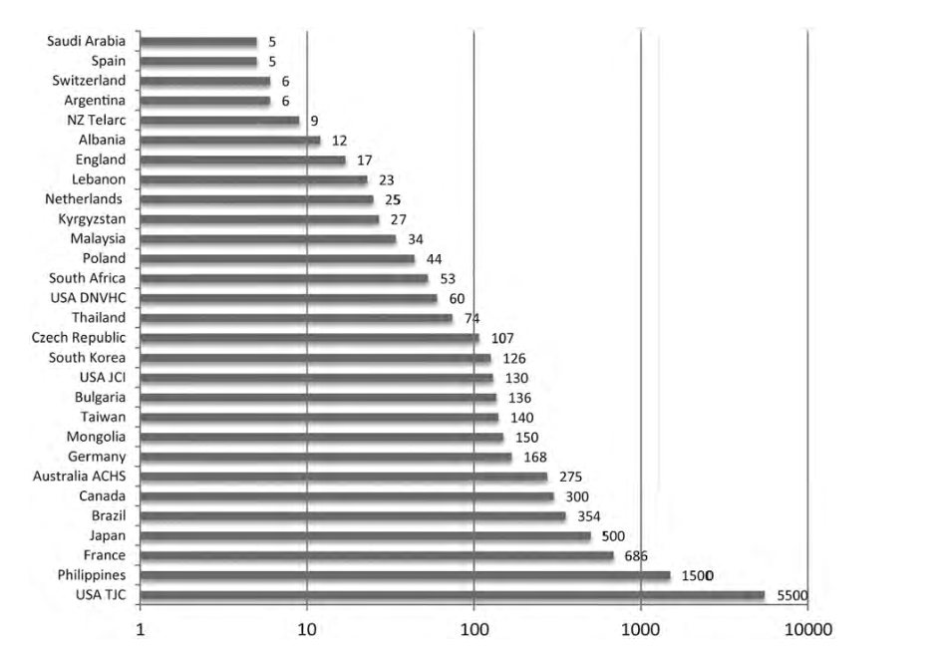
Institutions surveyed

Slide 13
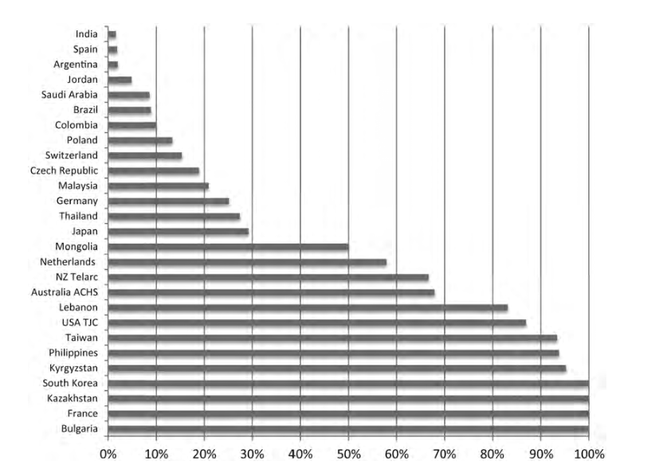
Percent of eligible accredited

Slide 14
Do not forgot about benefits of performance measures

Slide 15
Performance indicators
or quality indicators
measures in numbers how well healthcare provider performs
including
  outcome indicators
  process indicators
  cost/effectivenes measures
  but also less important structure indicators

Slide 16
Sources of data for calculation of indicators
Claims for reimbursement of expenditures from insurers or government
Self-reported indicators
Individual patient data-bases - patient clinical registers that collect
    whom
    what
    results positive and negative

Slide 17


Project POINTer

Slide 18
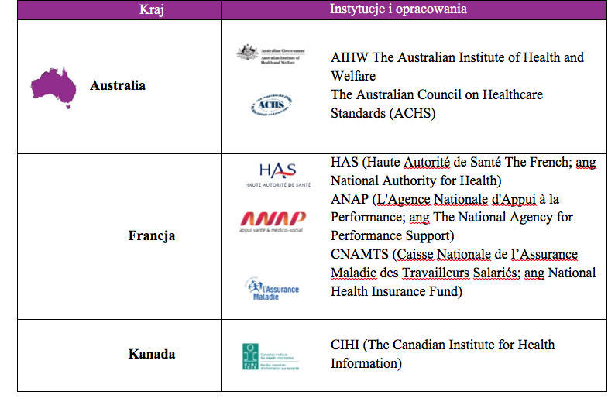
Project POINTer

Slide 19
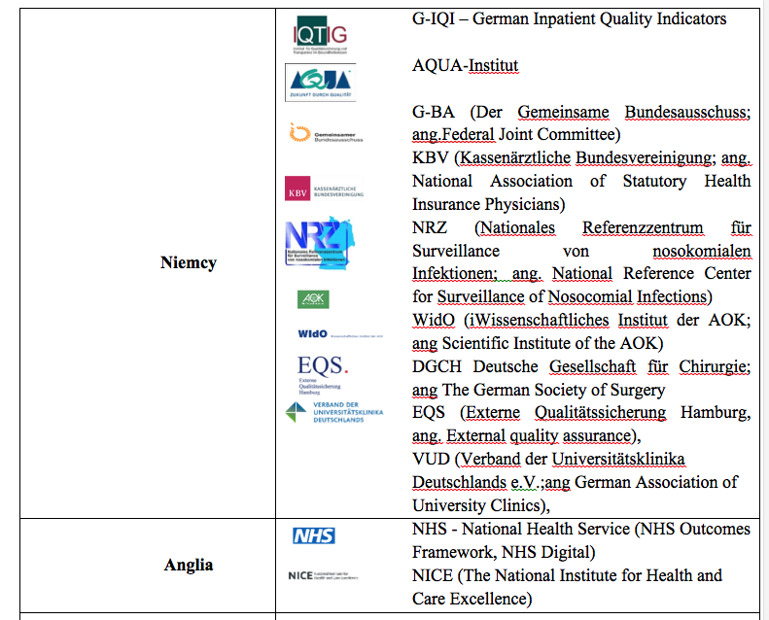
Project POINTer

Slide 20
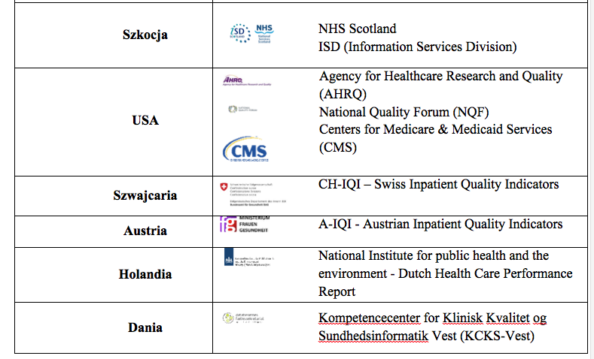
Project POINTer

Slide 21
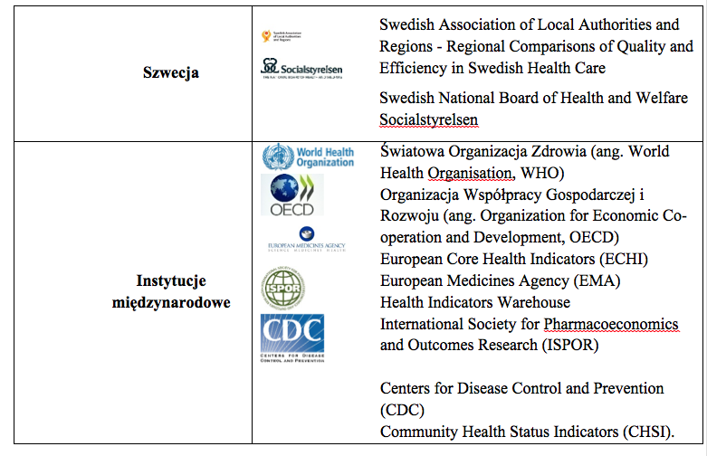
Project POINTer

Slide 22
Project POINTer
Conclusions
  more than 3 500 quality indicators
  different sources of data
  best impact - national quality registers
    Sweden
    Denmark
    Australia

Slide 23

Project POINTer

Slide 24
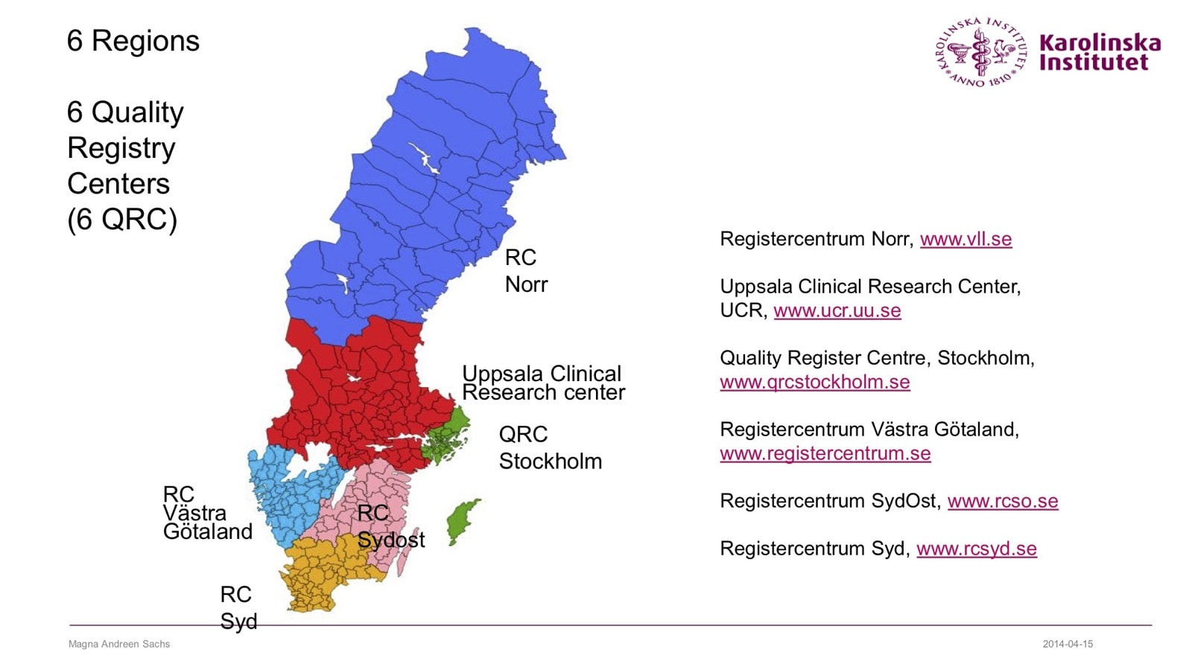
Sweden
Quality Registry Competence Centers

Slide 25
Evaluation of events with different rate
often events - patient registers
rare harms, near misses - reporting and root causes analysis and precaution implementation (patient safety)

Slide 26
Patient safety

Slide 27
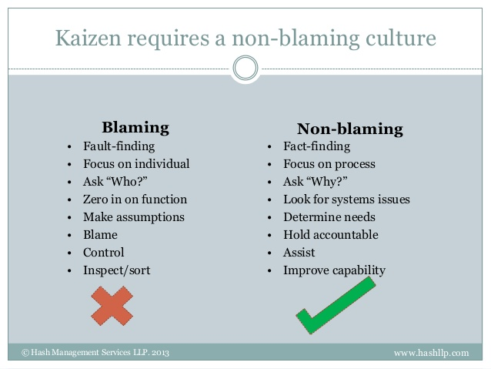
non-blaming, non-fault
main condition for reporting adverse events

Slide 28
Necessary - special law
like in Denmark or Norway

Slide 29
Non-fault law
against long term tradition of our countries
slow changes of attitude
many discussions about how to shift from searching guilty person to learn how to implement effective precautions
nurses should be leaders in discussing patient safety issues

Slide 30
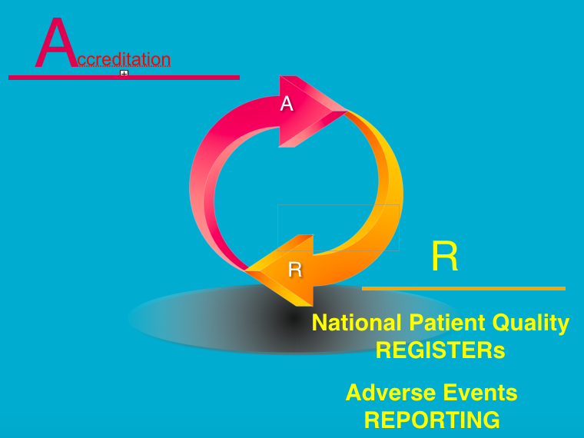

Slide 31

thank you for your attention
r.nizankowski@gmail.com

